Slide 1
Lab 9

Slide 2
Binary Tree Node
Node for a binary tree
Functions for manipulating a BST
Private variables:
Item data_field; //data field of a node
binary_tree_node *left_field; //pointer to the left sub-tree
binary_tree_node *right_field; //pointer to the right sub-tree
Implement this class first before going to Bag
Look to lecture slides for guidance

Slide 3
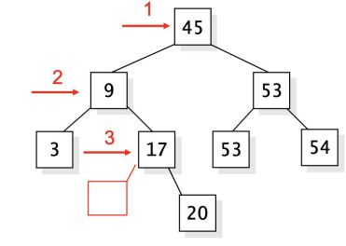
Bag
A container template class for a collection of items
Stores these items in a BST
Private variables:
Binary_tree_node<Item> *root_ptr; //root pointer of BST
Implement this class after completing binary tree node
Look to lecture slides for guidance

Slide 4
Provided Files
bintree.h
bag_bst.h
bagexam.cpp
No need to create any other files

Slide 5
Don’t Forget
Demo code to me
Today or next week
Usually I will NOT be available on weekends -- plan accordingly.
Must compile and run on linux servers
Submit your code before deadline
Comment code
File with description of lab is on Camino
Submission guidelines

